Slide 1


实用科技英语翻译
通信2101蔡磊
2023.5.24

Slide 2


目录
一：课内知识回顾
二：个人展示

Slide 3
课内内容复习
词的翻译：副词和介词

Slide 4
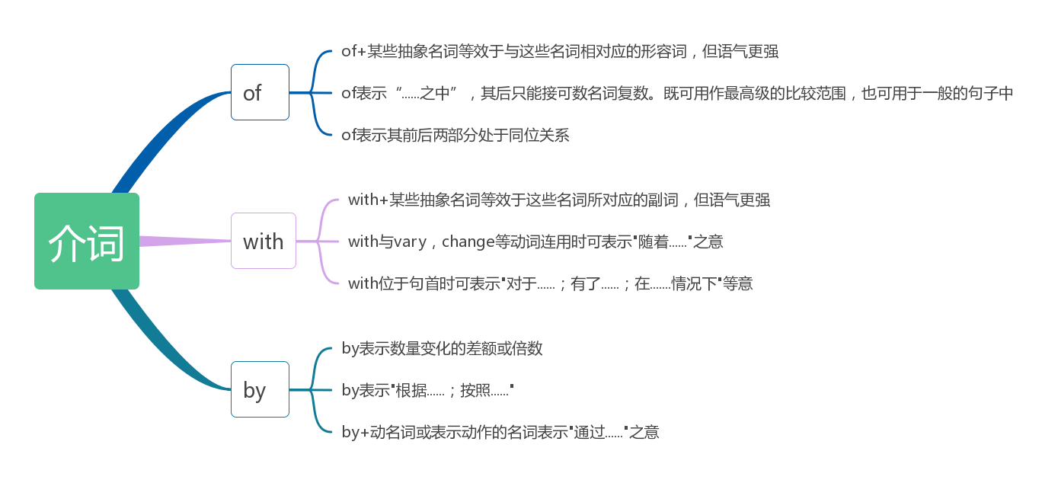


上节内容复习
输入题目
输入题目
您的内容打在这里，或者通过复制您的文本后，在此框中选择粘贴，并选择只保留文字。
您的内容打在这里，或者通过复制您的文本后，在此框中选择粘贴，并选择只保留文字。
输入题目
输入题目
您的内容打在这里，或者通过复制您的文本后，在此框中选择粘贴，并选择只保留文字。
您的内容打在这里，或者通过复制您的文本后，在此框中选择粘贴，并选择只保留文字。

Slide 5

1.of+某些抽象名词等效于与这些名词相对应的形容词，但语气更强。此时，”of“的意思为”具......”。例如：
（1）这些资料对我们的实验特别有价值
These data are of particular value to us in our experiment
（2）学生们的实践活动是至关重要的
What the students do in their practice is of great importance

Slide 6
2.of表示“......之中”，其后只能接可数名词复数。既可用作最高级的比较范围，也可用于一般的句子中，例如：
（1）在这三种情况中，仅仅最后这种是可接受的
Of these three circumstances, only the last is acceptable
(2)在飞船所载的11件仪器中，有2件来自美国， 4件来自欧洲
Of the eleven instruments carried by the spaceship, two were from U.S. , and four from Europe

Slide 7
3.of表示其前后两部分处于同位关系。例如：
（1）翘曲机翼的概念由此诞生
Thus, the concept of wing warping was born
(2)水的比喻可以帮助解释电的概念
The analogy of water can help explain the concept of electricity

Slide 8
1.with+某些抽象名词等效于与这些名词所对应 的副词，但语气更强。例如：
（1）科学仪器的制造必须非常精密
Scientific instruments have to be made with great precision
(2)病员的数量正以惊人的速度增加
The number of the sick was increasing with appalling rapidity

Slide 9
2.with与vary,change,increase,decrease等动词连用时可表示“随着......”之意。例如：
（1）随着对地下水资源需求的增多，地下水水权冲突现象愈演愈烈
The conflicts of the right to groundwater are becoming increasingly intense with the increase of its demand
(2) 冷血动物的体温随着周围环境温度的变化而变化
The temperature of cold-blood animals changes with the temperature of the surroundings

Slide 10
3.with位于句首时可表示“对于......;有了......;在......情况下”等意。例如：
（1）在作用力不变的情况下，加速度和质量成反比
With a constant force, the acceleration is inversely proportional to the mass
(2) 有了互联网，两个或几个相距较远的人可以轻 易地一同写同一报告
With the Internet, it is easy for two or more people far apart to write a report together

Slide 11
1.by表示数量变化的差额或倍数。例如：
（1）1983年以来，电视机的产量增加了三倍
The production of TV sets has been increased by a factor of 4 since 1983
(2) 在交流电路中，若电压，电流相位正好相差90°，则电路上消耗的功率为零
!
In Ac circuits, the power consumed in a circuit will be zero if the voltages and currents differ in phase by 90°

Slide 12
2.by表示“根据......；按照......”。例如：
（1）根据有关理论，科学家们有了下面的推测
By the relevant theories, scientists made a speculation below
(2) 根据欧姆定律，我们可以知道电流，电压和电阻之间存在的关系
By Ohm’s law, we can know the relation between current, voltage and resistance

Slide 13
3.by+动名词或表示动作的名词，表示”通过......“之意，例如：
（1）通过该系统的应用，实现了生产过程的自动化和标准化
By the application of this system, the process of production becomes automatic and standardized
(2) 采用数字信号技术已将火星图片成功传输到地球
The pictures of the Mars have been transmitted successfully to the earth by using digital techniques

Slide 14
词语解释
cloud computing 云计算
subversive a.从事颠覆的，破坏性的 n.破坏分子
innovation n.改革，创新
transmit vt.传输，传染，遗传，发射 vi.发射信号，流传下来
terminal n.终端机，终点，末端 a.终点的，定期的，晚期的
transmission n.传输，传达，变速器
extent n.范围，程度，区域
remarkable a.不平常的，值得注意的，显著的
option n.选择权，挑选，选项
multiplayer a.多人的（特指电子游戏），多玩家的
graphics n.制图法，图形
storage n.储存器，保管，库存，仓库
bandwidth n.频带宽度，通带宽度
jam n.果酱，堵塞，困境 vt.挤进，使塞满，压碎，使堵塞 vi.堵塞，轧住，拥挤
latency n.潜伏，潜在
broadband n.宽带
privacy n.隐私，私密
disclosure n.披露，公开，暴露的事实
comprehensive a.综合的，全部的 n.综合中学
vigorously ad.精神旺盛地，活泼地
accelerate v.加快，加速
blockchain n.块环链，车链

Slide 15
词语解释
enable vt.使可能，使可行
circulation n.循环，流通，传递，发行量，交际，销售量
optimize vt.优化，充分利用
indispensable a.不可或缺的，必不可少的 n.不可缺少的人或物
irreplaceable a.不能替代的

Slide 16

In recent years, the emergence of emerging technologies such as cloud computing and artificial intelligence has led to great development in all walks of life. Among them, as the latest subversive innovation in the game industry, cloud games have become a necessary technology in the game industry and are developing rapidly. This article will discuss the development and trend of cloud game technology from the aspects of the development history of cloud games, the current situation, advantages and disadvantages of cloud game technology, and the future challenges and trends faced by cloud games.
近年来，云计算、人工智能等新兴技术的出现，让各行各业都得到了长足的发展。其中，云游戏作为游戏行业最新的颠覆式创新，已经成为游戏行业的必备技术，正在迅速地发展壮大。本文将从云游戏的发展历程、云游戏技术的现状及优缺点、以及云游戏面临的未来挑战和趋势等方面，探讨云游戏技术的发展及其趋势。

Slide 17

Cloud games originated from Internet TV games. It is a form of games that transmit game screens to user terminals with the help of high-speed Internet connection. The earliest cloud games appeared around 2000, when cloud games had not been developed enough due to the limitations of network transmission technology. It was not until around 2010, due to the progress of cloud computing technology, that cloud games began to enter the public eye and became one of the hottest topics in the game industry.
云游戏最早起源于互联网电视游戏，是一种借助高速互联网连接，将游戏画面传输到用户终端上运行的游戏形式。最早的云游戏出现于2000年左右，当时由于网络传输技术的限制，云游戏还没有得到足够的发展。直到2010年左右，由于云计算技术的进步，云游戏才开始进入大众视野，成为游戏行业最热门的话题之一。

Slide 18

Cloud game technology has developed to a certain extent and has achieved remarkable results. Its main technical routes include cloud games based on streaming media transmission, browser-based cloud games, and cloud server-based games. So far, cloud game technology has a variety of options such as multiplayer online games, high-quality, 3D virtual reality, etc. However, there are also some advantages and disadvantages of cloud game technology. The advantage is that cloud games allow players to play high-quality games without high-performance graphics cards without considering storage space. At the same time, the distribution of cloud games is also more convenient; the disadvantage is that the delay of the network will affect the game experience. Players of cloud games need to have enough network bandwidth and a stable network connection, otherwise there may be problems such as stuttering and disconnection.
云游戏技术已经发展到了一定的程度，取得了较为显著的成果。其主要技术路线有基于流媒体传输的云游戏、基于浏览器的云游戏、基于云服务器的云游戏。至今，云游戏技术已经具备了多人在线游戏、高画质、3D虚拟现实等多种选择。然而，云游戏技术也存在一些优缺点。其优点在于云游戏可以让玩家不需要高性能显卡就能玩到高画面质量游戏，无需考虑存储空间。同时，云游戏的分发也更为便捷；缺点则在于网络的延迟会对游戏体验有所影响。云游戏的玩家需要有足够的网络带宽和稳定的网络连接，否则可能会出现卡顿、掉线等问题。

Slide 19
Although cloud games have many advantages, they also face many future challenges. One of the biggest challenges is the problem of network latency. Although broadband network technology has made great progress, the network speed is still not stable enough, and the delay problem is still one of the biggest problems. Secondly, cloud games should do a good job in the protection of player data. Game data, personal data, etc. in cloud games may face the risk of privacy disclosure. Finally, cloud games should solve the problem of game balance. When playing games on different devices, the player's comprehensive ability of the device will be different, which is a great challenge to the balance of the game.
虽然云游戏有很多的优点，但是它也面临着许多未来挑战。其中最大的挑战就是网络延迟的问题。虽然现在宽带网络技术已经取得了很大进步，但是网速仍然不够稳定，延迟问题依然是最大问题之一。其次，云游戏要做好玩家数据的保护。云游戏中的游戏数据、个人数据等，可能面临着隐私泄露的风险。最后，云游戏要解决游戏平衡性问题。在各种不同的设备上进行游戏时，玩家的设备综合能力会有差异，对于游戏的平衡性是很大的挑战。

Slide 20

In the future, cloud game technology will develop in the following aspects: first, vigorously develop 5G network technology to accelerate the transmission speed of cloud games and improve the quality of cloud games; second, quickly develop artificial intelligence technology to combine cloud games with AI to increase players' game experience; third, introduce blockchain technology to empower the effective circulation of game data. Through the above upgrades, the user experience of cloud games will be greatly optimized.
未来的云游戏技术将会在以下几方面发展：第一、大力发展5G网络技术，加快云游戏的传输速度，提升云游戏的品质；第二、快速发展人工智能技术，将云游戏与AI相结合，增加玩家的游戏体验；第三、引入区块链技术赋能游戏数据有效流转。通过以上升级，将会极大地优化云游戏的用户体验。

Slide 21

Conclusion In a word, cloud game technology will have more far-reaching influence and value, and there will be indispensable technical challenges and improvement solutions on the road to development. The continuous improvement and expansion of future development will certainly become an irreplaceable part of the game industry. The development of cloud games may be very long, but the future development direction and trend are very clear.
未来的云游戏技术将会在以下几方面发展：第一、大力发展5G网络技术，加快云游戏的传输速度，提升云游戏的品质；第二、快速发展人工智能技术，将云游戏与AI相结合，增加玩家的游戏体验；第三、引入区块链技术赋能游戏数据有效流转。通过以上升级，将会极大地优化云游戏的用户体验。第六章：结论总之，云游戏技术将会有更加深远的影响力和价值，而在发展之路上也有着不可或缺的技术挑战和改进方案，在未来的发展中持续的提高和扩展，必将成为游戏行业不可替代的一部分。云游戏的发展可能还很漫长，但未来的发展方向和趋势已经非常的清晰。

Slide 22
感谢观看

